Slide 1
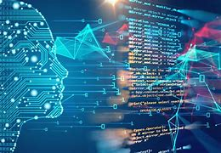

Capstone Project(Team No- 47)

Slide 2
Group Members-
Aman Gupta 19BCE10289
Vaghasia Aum, 19BCE10437
Yash Saxena, 19BCE10115
Bommakanty Satya Sai Anirudh, 19BCE10045

Slide 3
Project Title: Predicting Stock and Crypto Market with Machine Learning.
Project Description:
Investing in Stock has increasingly become a lot more popular than it was. People now a days can now invest in stock by sitting in the comfort of their homes and right from their mobile phones or their personal computers. In this project, we are going to display the stock prices of the companies along with the prediction of the stock prices.
Another popular trend which has increased in past couple of years is investing in crypto. With the start of Bitcoin in 2009 which was the first cryptocurrency ever made, the crypto market gradually grew from there and has an estimated market cap of $891 billion.

Slide 4
Proposed Work
This project attempts to predict the stock value and crypto value with respect to the previous value and trends. It requires historic data of both the market as the project also emphasizes on data mining techniques. The purposed method for developing the system consists of mainly three main steps.
Firstly, data is collected and sorted for relevancy from various sources.
Secondly, analysis is carried out on the collected data by examining the current market direction, tracking the industry group, specific companies and the crypto coins after which the data is represented and scored accordingly.
At last, a model is designed with suitable algorithm which gives the best accurate data and that is chosen to predict the stock and crypto value.

Slide 5
Methodology
Stock and crypto market prediction seems a complex problem because there are many factors that have yet to be addressed and it doesn’t seem statistical at first. But by proper use of machine learning techniques, one can relate previous data to the current data and train the machine to learn from it and make appropriate assumptions.
Machine learning will be used to make the predictions which will be done by feeding data to our model and training it by using this data.
Python will be used for this purpose with the special libraries included in it which are- Numpy, Matplotlib and Pandas libraries in Python.
Long short-Term memory(LSTM) will also be used in the project.

Slide 6
Novelty of the Project and its Real time usage
Time consumed in accessing the real time data of both stock and crypto market will be reduced.
Unlike other websites the one which we are making will display both crypto market and stock market prices.
The prediction graphs will help the consumer know where to invest next or where to cash out from if they have invested in any of the companies or crypto coins.
Easy to understand and easy to use.

Slide 7
Hardware and Software Requirements
Our software will run on every device which has windows or any other operating system installed and a stable internet connection.
We will have minimalistic design and will keep it simple.
We will have less animations in our software due to which user can have Seamless Experience.
Hardware required will be – 4gb ram or more. Stable internet connection, and 2gb or more than that storage.

Slide 8
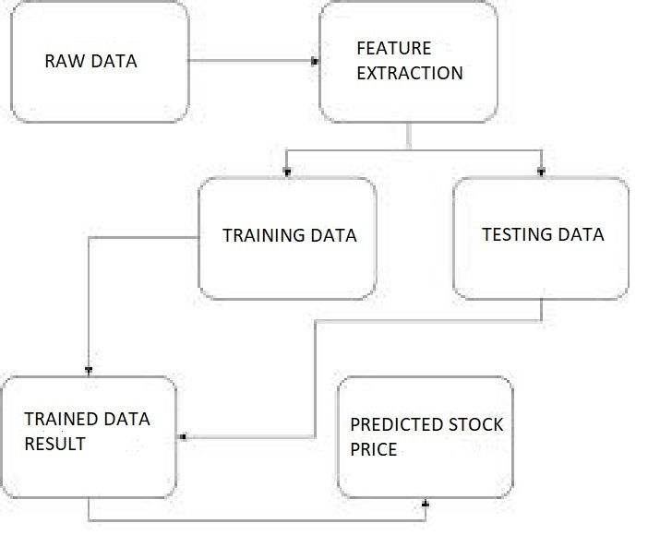
FLOW DIAGRAM

Slide 9
SYSTEM ARCHITECTURE
A stock analysis system typically includes the following components:
Data storage: This component stores historical stock data, financial statements, news articles, and other relevant information that will be used to analyze the stock. This data can be stored in a relational database, a NoSQL database, or a cloud-based storage service.
Data processing: This component is responsible for extracting, transforming, and loading the data into the system. It may use various techniques such as web scraping, natural language processing, and machine learning to extract relevant information from the data.
Modeling: This component uses the processed data to create a model that can be used to predict future stock prices or perform other types of analysis. This component may use various machine learning algorithms such as linear regression, decision trees, or neural networks.
All these components are connected to each other and work together to provide a comprehensive stock analysis system.

Slide 10
SYSTEM ARCHITECTURE
Visualization: This component displays the results of the analysis in a user-friendly format, such as a graph or a table. It may also provide various interactive features that allow users to explore the data in more detail.
User interface: This component allows users to interact with the system, such as by entering stock symbols, choosing analysis parameters, or viewing the results of the analysis.
Backend: This component handles the business logic, data access and management, and communication with the other components.

Slide 11
Module split-up
In our crypto market analysis, we have downloaded the data from Yahoo Finance website and analyzed it with the help of python
LSTM Networks - Long Short Term Memory networks are a special kind of RNN, capable of learning long-term dependencies. They work tremendously well on a large variety of problems, and are now widely used. LSTMs are explicitly designed to avoid the long-term dependency problem.
Remembering information for long periods of time is practically their default behavior, not something they struggle to learn. All recurrent neural networks have the form of a chain of repeating modules of neural network.
In standard RNNs, this repeating module will have a very simple structure, such as a single tanh layer.

Slide 12
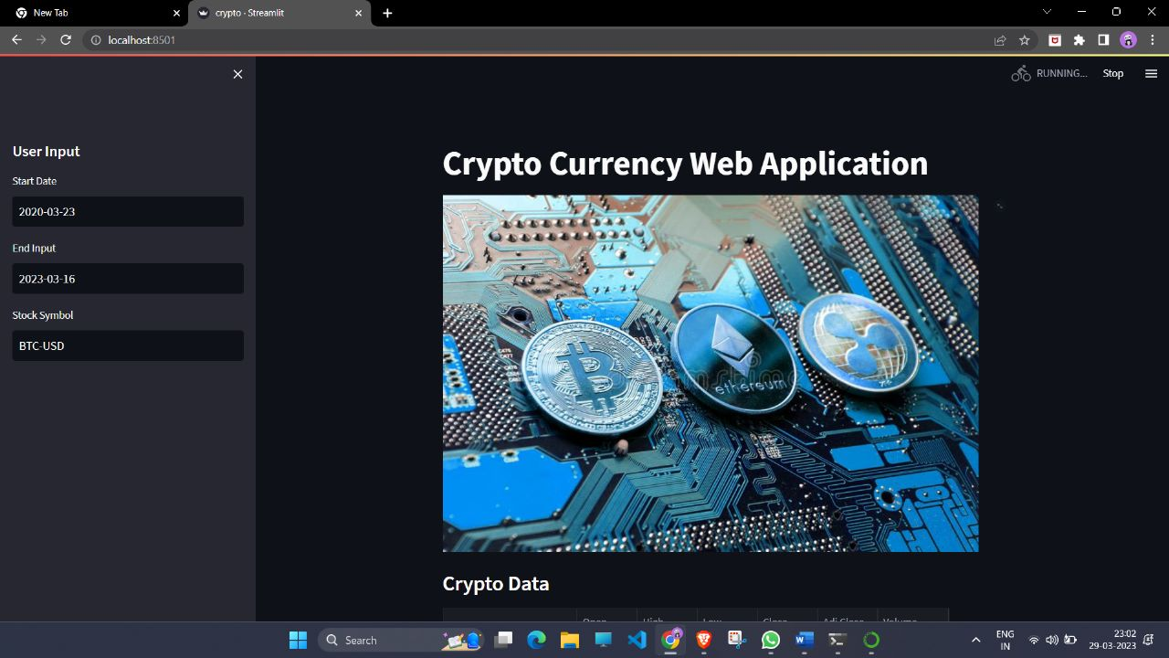
Snap shot of your project

Slide 13
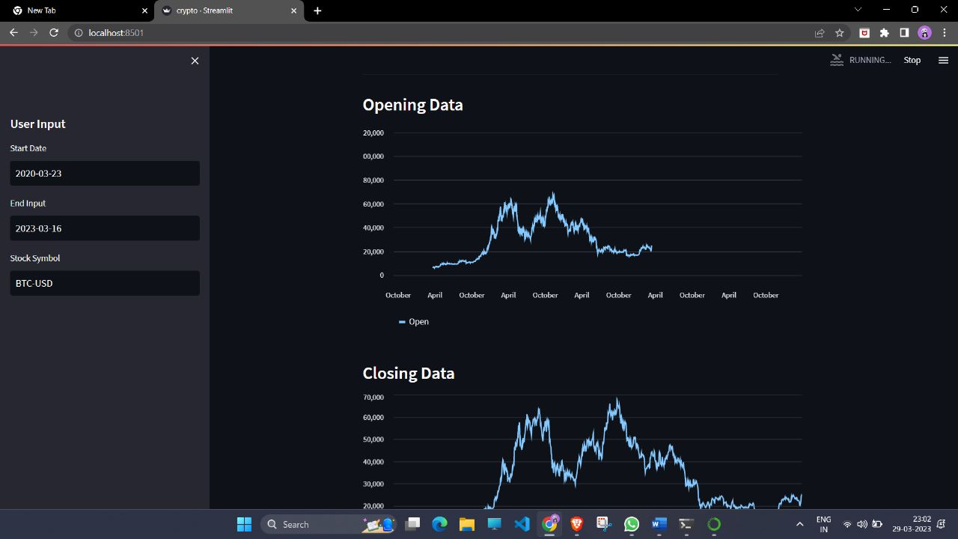
Snap shot of your project

Slide 14
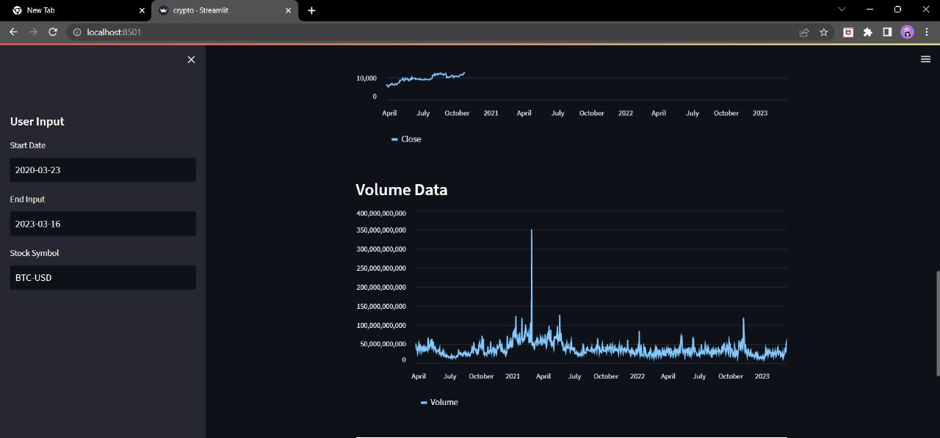
Snap shot of your project

Slide 15
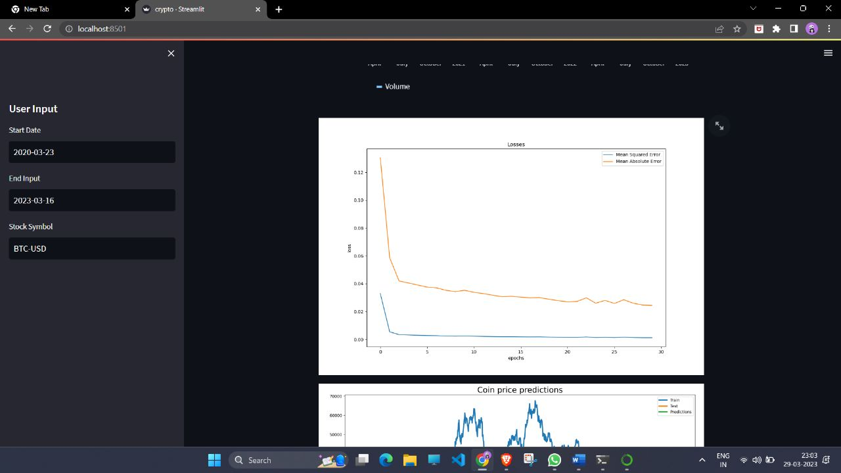
Snap shot of your project

Slide 16
REFERENCES
https://www2.cs.uh.edu/~ceick/UDM/Understanding_RNN.pdf
https://colah.github.io/posts/2015-08-Understanding-LSTMs/
https://datascience.stackexchange.com/questions/55811/getting-stock-data-in-a-discipline-manner-from-yahoo-finance
https://link.medium.com/2bhoiqBmQwb
https://www.sciencedirect.com/science/article/abs/pii/S037704271930398X

Slide 17
Thank You. I hope you liked our presentation. Suggestions from your side is highly appreciated.
Have a Good Day

